Slide 1


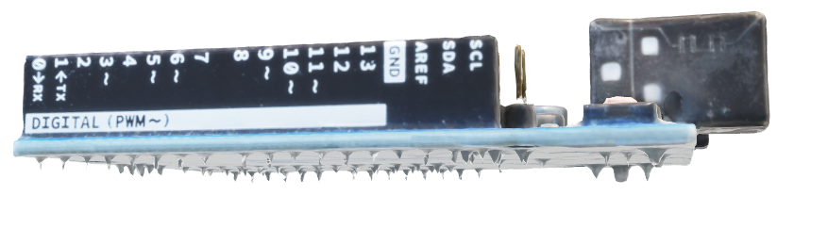

IoT GPS Speedometer using C++ (OOP) & ESP32
Presented by: S.PadeeepKumar
Registration Number: 192425016
Course Name: Object oriented programming using C++
Faculty: Dr. Thalapathy Rajasekar, Dr.Anbalagan
Institution: SIMATS Engineering

Slide 2

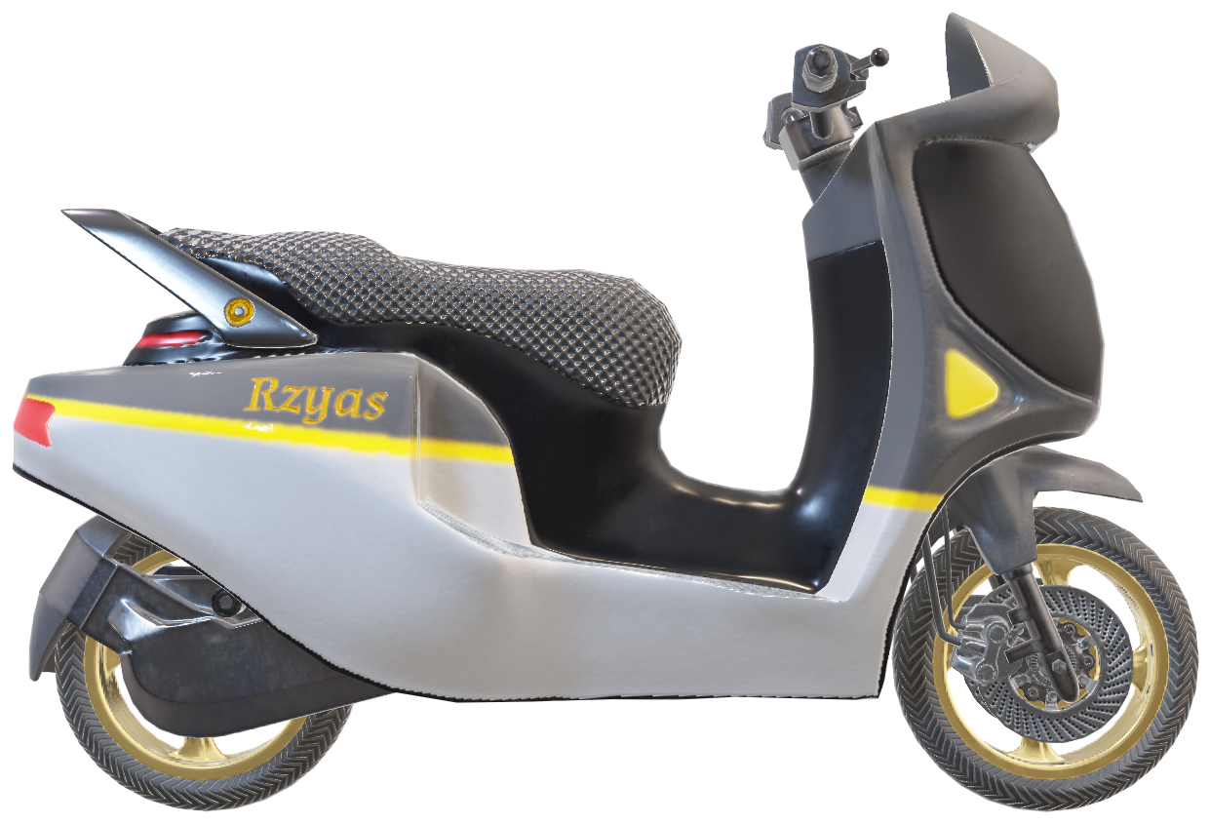


Contest
Introduction
Abstract
Problem Statement
Objection & Solution
Algorithm
Flow chart
Pseudocode
Input/Output
Results

Slide 3
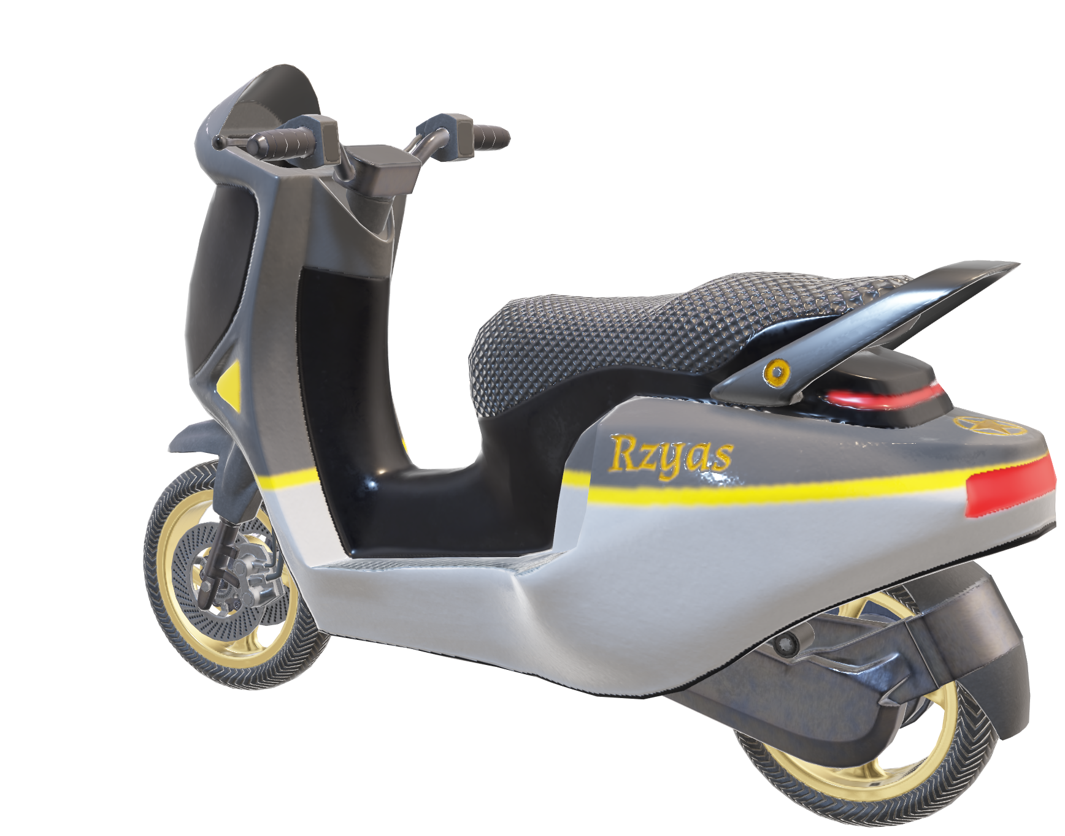


INTRODUCTION
USING OBJECT ORIENTED PROGRAMMING IN C++, DEVELOPING A GPS BASED SPEEDOMENTER FOR ELECTRIC VEHICLES

Slide 4
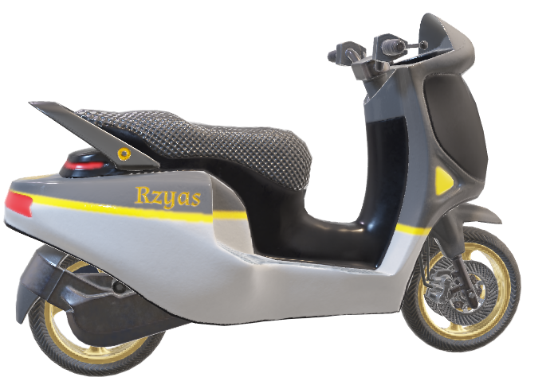
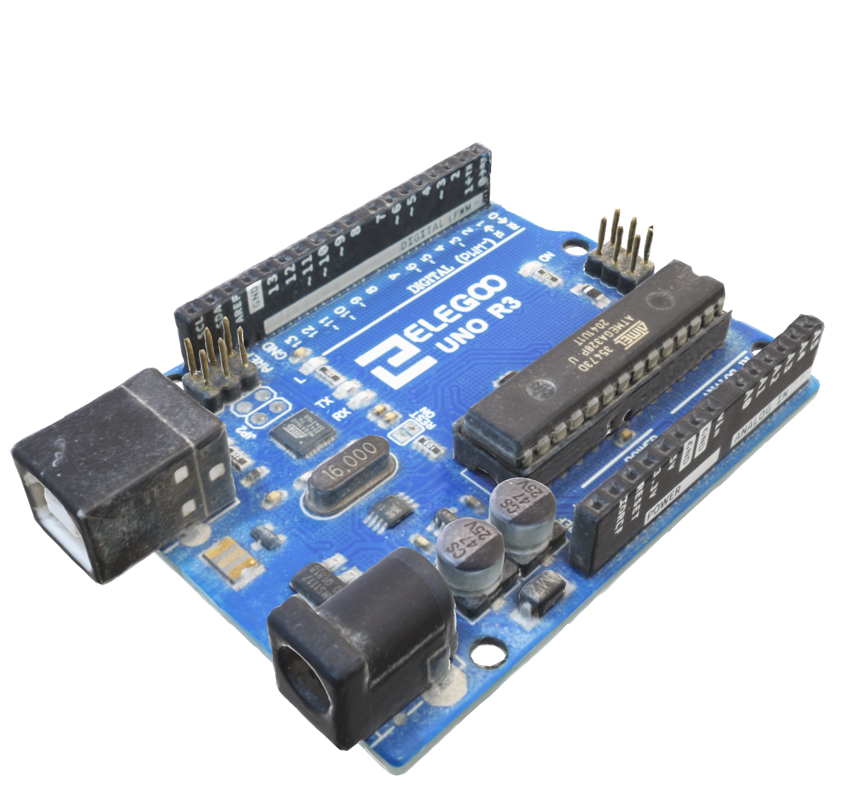
ABSTRACT
This project implements a real-time speed monitoring application using Object-Oriented Programming (OOP) principles in C++. The system is designed with modular classes to handle GPS data acquisition, speed calculation, and graphical rendering on a TFT display. Encapsulation and abstraction ensure a clear separation between data processing and display logic, improving maintainability and scalability. The ESP32 microcontroller serves as the runtime environment, while the software architecture focuses on efficient serial data parsing, smooth UI transitions, and robust handling of GPS connectivity states. The result is a responsive and visually appealing speedometer application that demonstrates the application of core C++ OOP concepts in an embedded environment.

Slide 5
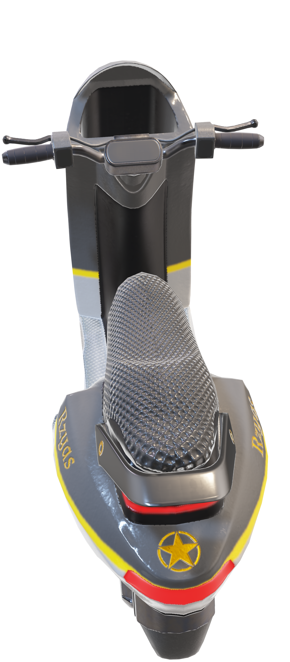
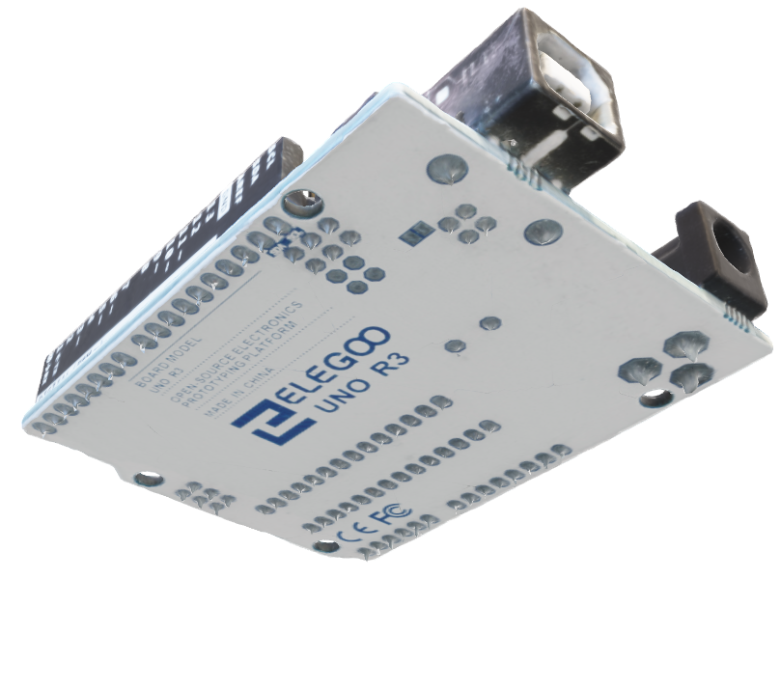
Problem
Problem Statement:
- Traditional mechanical speedometers are prone to wear and tear over time.
- Repair and recalibration require manual intervention, increasing maintenance time and cost.
- Manufacturing cost increases due to complex mechanical parts.
- Accuracy decreases over time due to component degradation or wheel size changes.
- Cannot provide extra information like GPS coordinates, satellite status, or signal strength.
- Performance is affected by environmental factors such as wheel slip or terrain.
- These limitations led to the development of a GPS-based digital speedometer with higher accuracy, reliability, and additional real-time data.

Slide 6
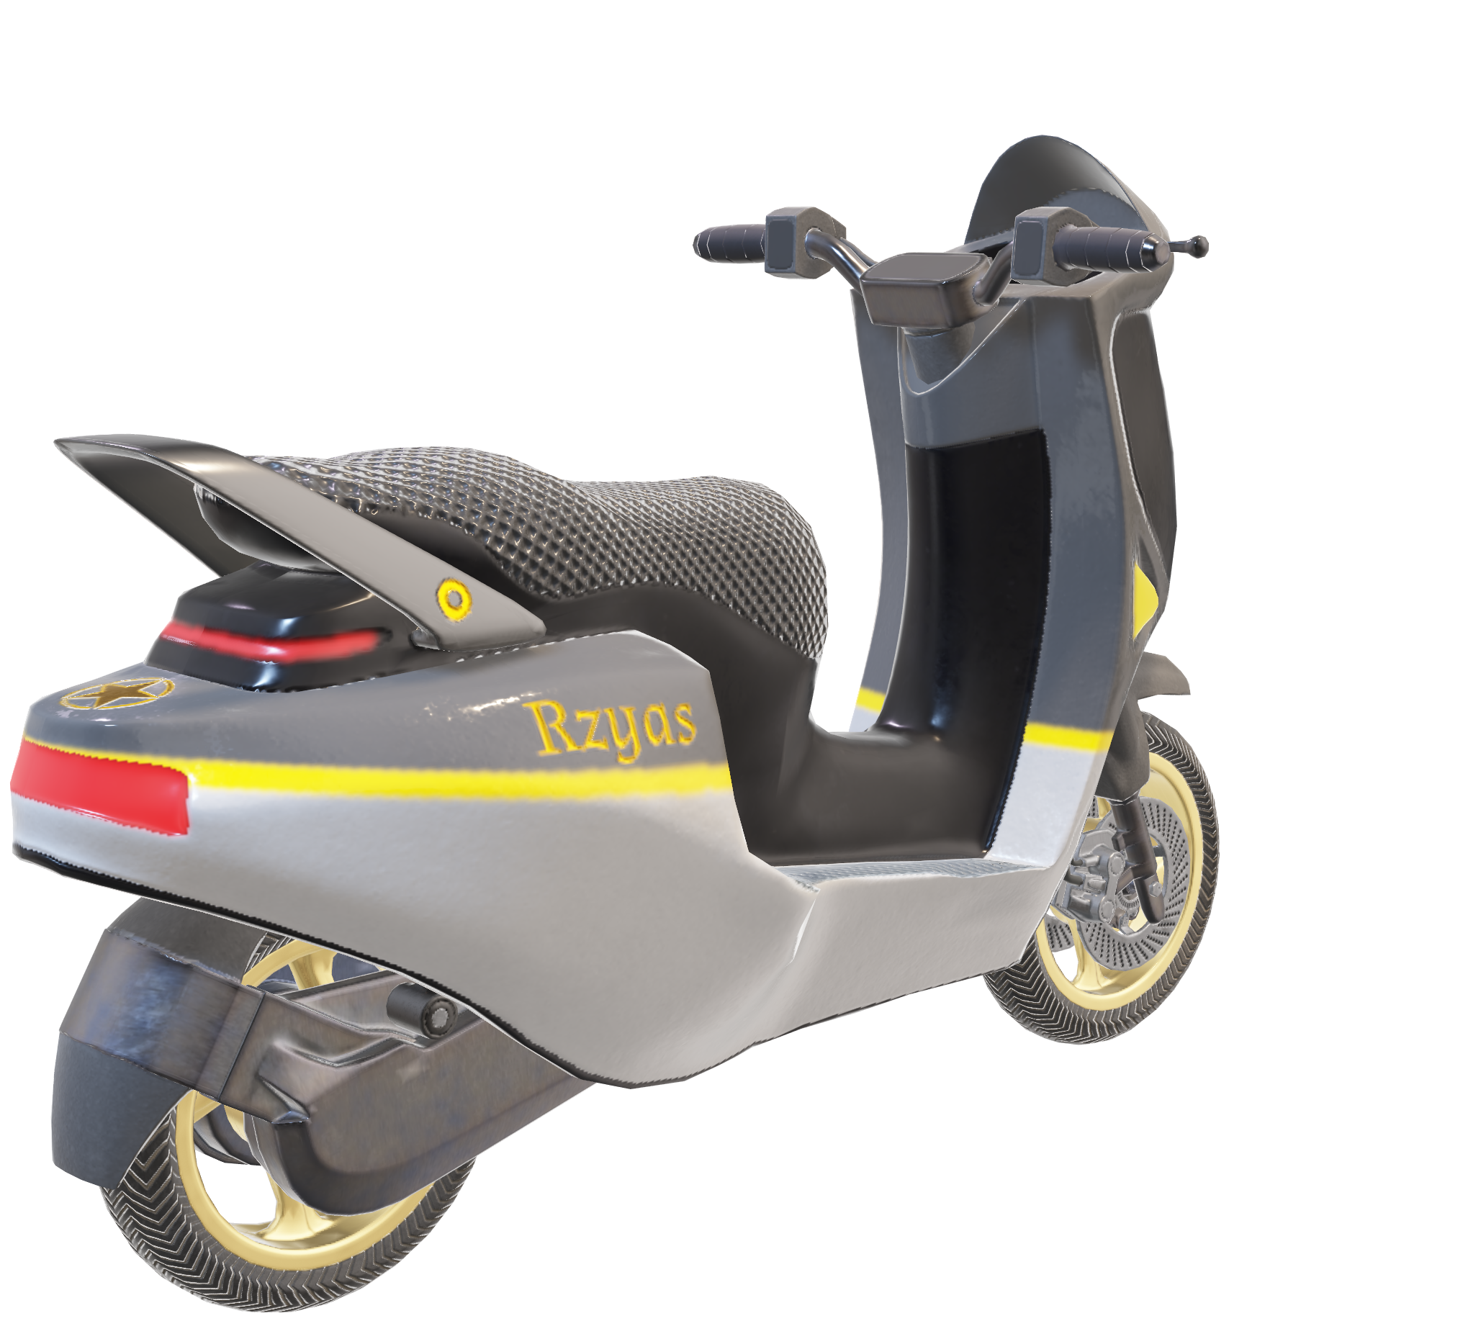

Objection and Solution
OBJECTION
SOLUTION
Speedometers can be wrong.
Tires affect speed reading.
Sensors may fail.
GPS speedometers look basic.
Use GPS for accurate speed.
Show latitude & longitude.
Warn if GPS lost.
Update display smoothly.
Use colors for GPS quality.
Portable device.
Problem Statement:
- Traditional mechanical speedometers are prone to wear and tear over time.
- Repair and recalibration require manual intervention, increasing maintenance time and cost.
- Manufacturing cost increases due to complex mechanical parts.
- Accuracy decreases over time due to component degradation or wheel size changes.
- Cannot provide extra information like GPS coordinates, satellite status, or signal strength.
- Performance is affected by environmental factors such as wheel slip or terrain.
- These limitations led to the development of a GPS-based digital speedometer with higher accuracy, reliability, and additional real-time data.

Slide 7
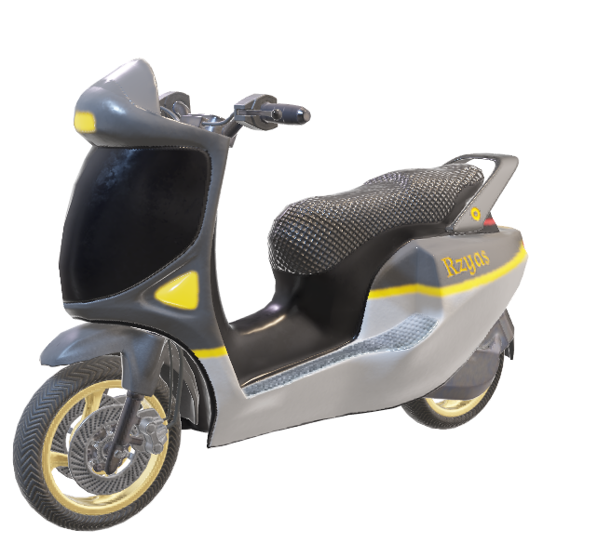
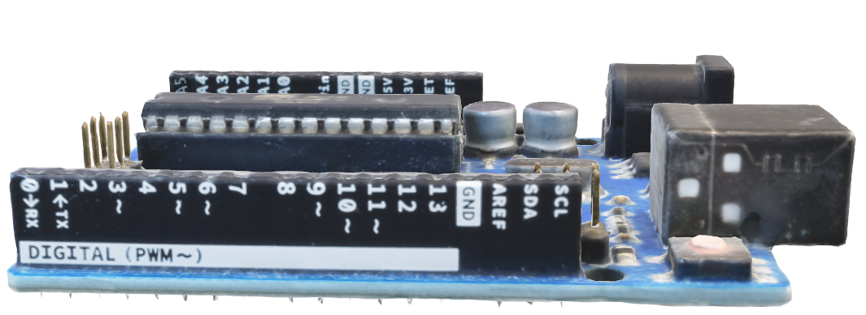
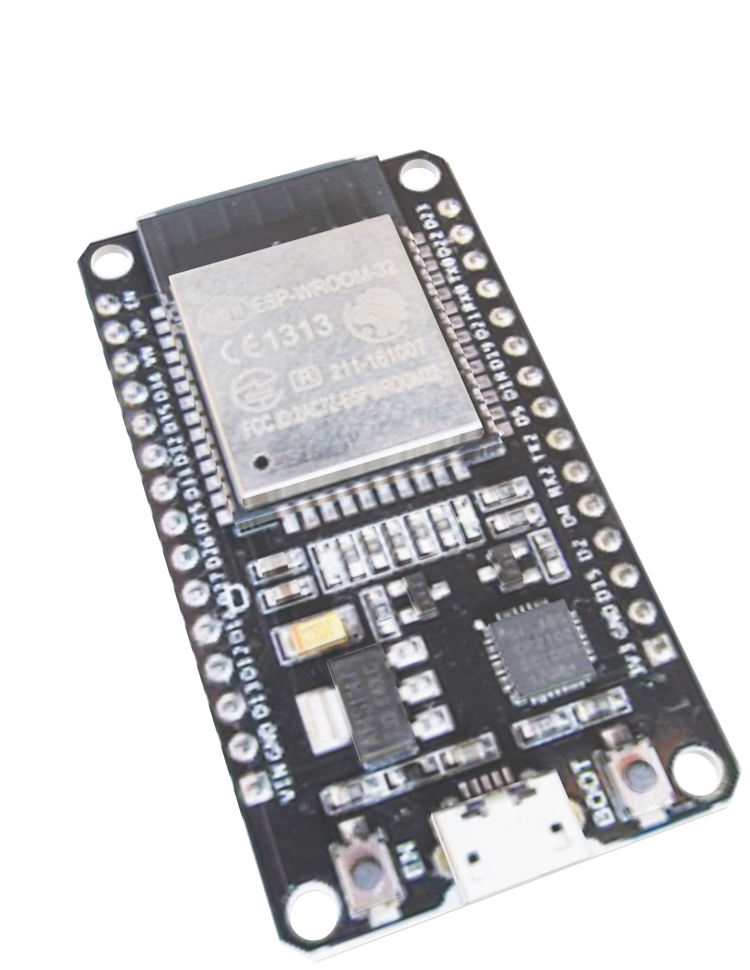
ALGORITHM
1. Initialize Objects – Create instances of GPSManager and DisplayManager classes, configure serial communication for GPS data input.
2. Begin Main Execution Loop – Continuously call class methods within the loop() function.
3. Acquire GPS Data – GPSManager::readData() reads and buffers incoming NMEA sentences.
4. Parse and Process – GPSManager::parseData() extracts speed, latitude, longitude, and satellite count, then validates the data.
5. Smooth Speed Output – Apply interpolation in SpeedProcessor class to prevent abrupt gauge jumps.
6. Update Display – Pass processed data to DisplayManager::updateUI() for gauge and text rendering.
7. Handle GPS Connectivity – If no valid data, trigger a “No GPS Signal” state in the UI.
8. Repeat Loop – Continue until system shutdown.

Slide 8
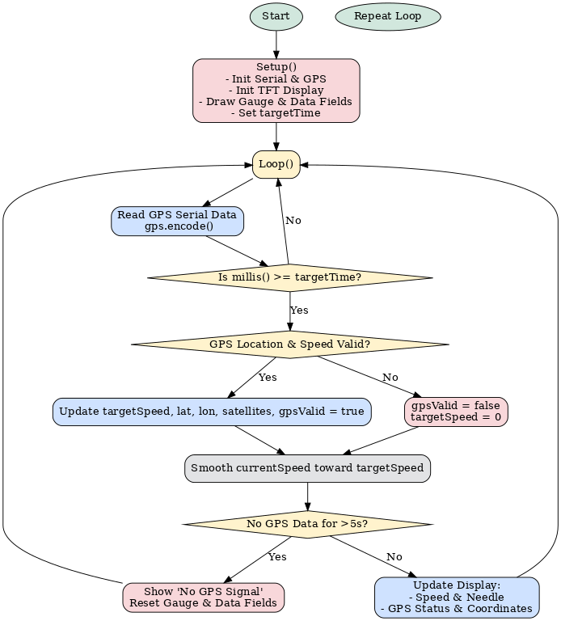
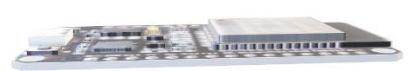
FLOW CHART
* Initialize GPS and display modules.
* Enter continuous execution loop.
* Read and process GPS data every **80 ms**.
* If GPS data is valid → update speed, location, and satellite count.
* If GPS data is invalid → set speed to zero.
* Apply smoothing algorithm for fluid gauge movement.
* If no GPS data for **>5 seconds** → show warning message.
* Otherwise → update display with speed, coordinates, and GPS status.

Slide 9



PSEUDOCODE
Create three main classes:
GPSManager → Handles reading GPS data, checking if it’s valid, and storing speed, coordinates, and satellite count.
DisplayManager → Handles drawing the speedometer gauge, showing speed, coordinates, and warning messages.
SpeedProcessor → Handles smoothing the speed so the needle moves smoothly.
Setup phase:
Initialize GPS and display objects.
Draw the gauge background and labels once at the start.
Set a timer to decide when to update the display.
Main loop:
Continuously read GPS data.
Every 80 milliseconds:
If the GPS data is valid → update the target speed, coordinates, and satellites.
If GPS data is invalid → mark it invalid and set speed to 0.
Smooth the speed so the gauge doesn’t jump suddenly.
If there is no GPS data for more than 5 seconds → show “No GPS Signal” and reset values.
Otherwise → update the display with the current speed, coordinates, and GPS status.
Repeat forever.

Slide 10
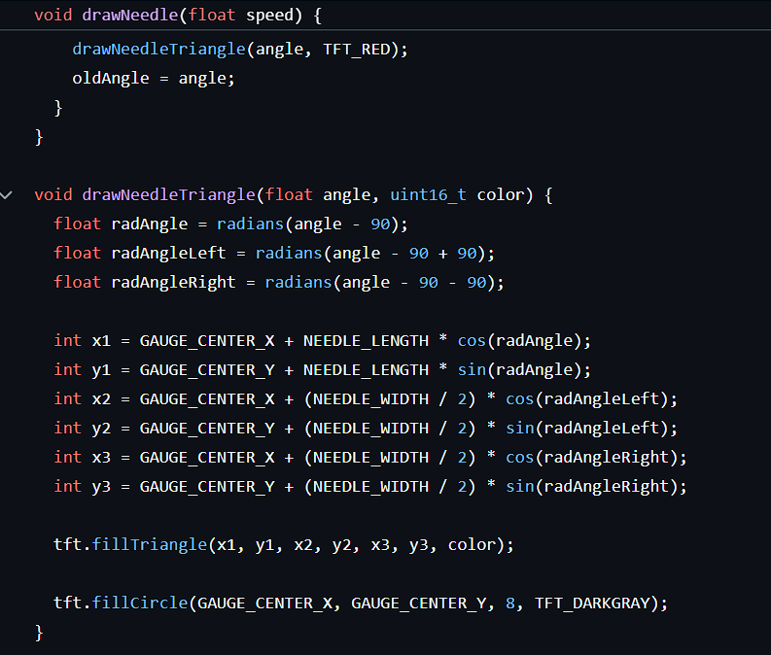
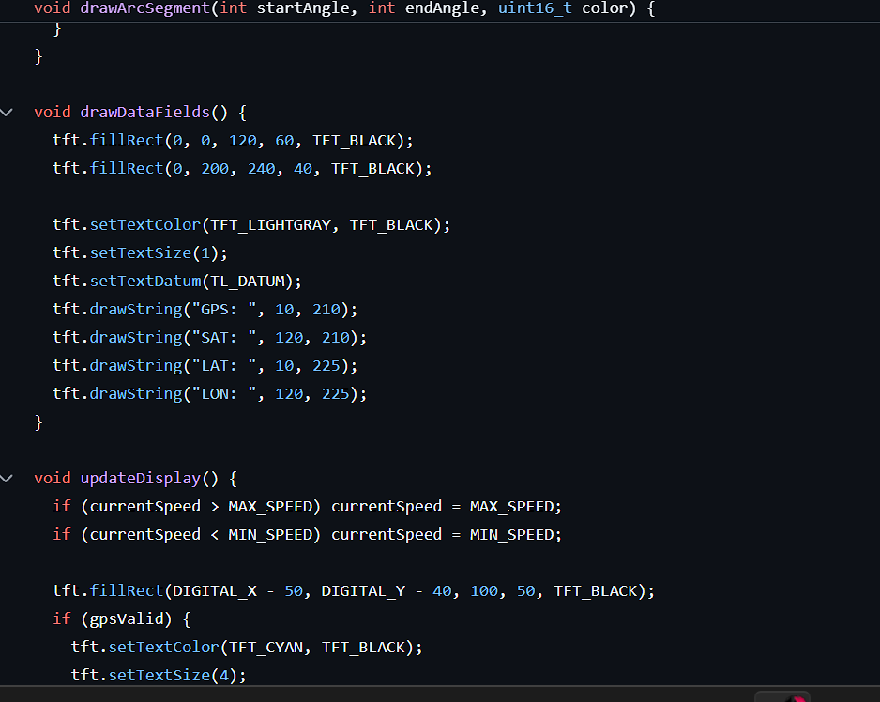
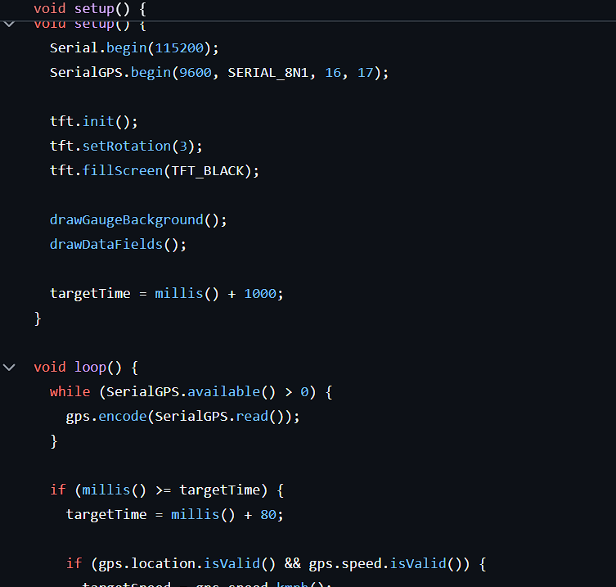



CODING

Slide 11
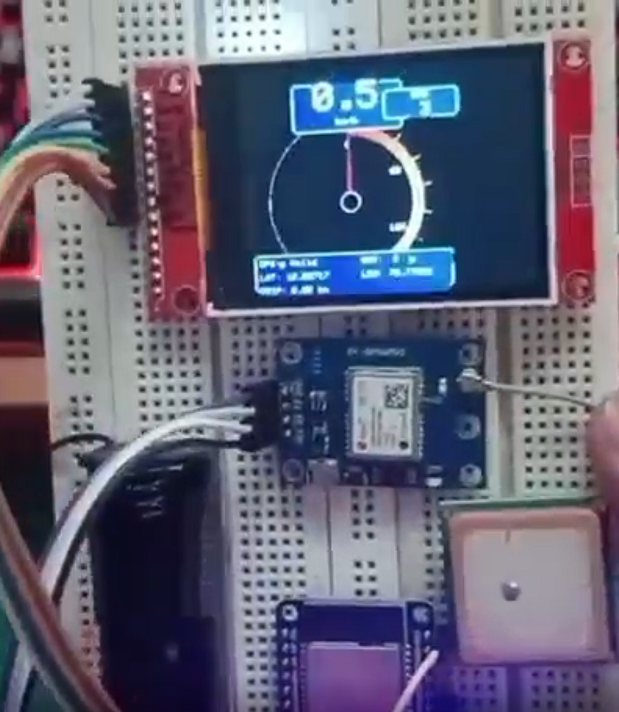
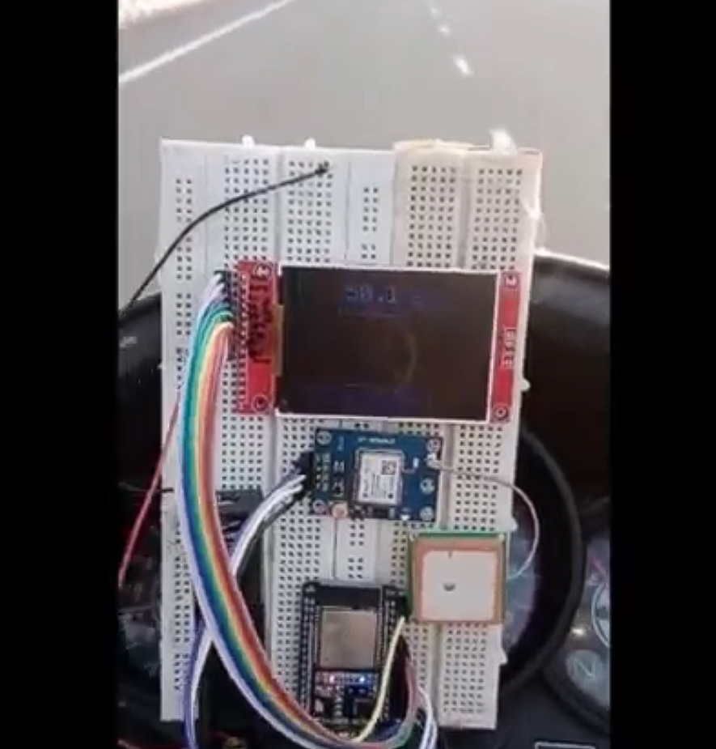



OUTPUT

Slide 12






Conclusion
Result:
- Implemented a modular C++ OOP architecture with separate classes: GPSManager, DisplayManager, and SpeedProcessor.
- Successfully parsed and validated GPS data for speed, coordinates, and satellite count using encapsulated methods.
- Achieved smooth speed transitions via interpolation handled by SpeedProcessor.
- Rendered real-time analog gauge and digital readout using DisplayManager, maintaining separation of UI and logic.
- Ensured robust error handling with a “No GPS Signal” state for data loss scenarios.
- Verified system accuracy and responsiveness through multiple real-world test runs.
Github repository link
https://github.com/pradeepkumar673
https://www.linkedin.com/in/pradeepkumarsurendiran

Slide 13



REFERENCE
1. Arduino Documentation – https://docs.arduino.cc/
2. TinyGPSPlus Library Reference – https://github.com/mikalhart/TinyGPSPlus
3. TFT_eSPI Library Reference – https://github.com/Bodmer/TFT_eSPI
4. ESP32 Hardware Serial Documentation – https://docs.espressif.com/projects/esp-idf/en/latest/esp32/api-reference/peripherals/uart.html

